Slide 1
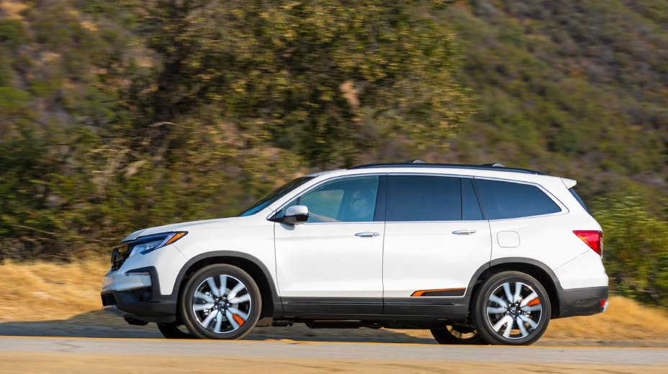
Sales and Production Update
2020: January
2020 Honda Pilot Elite

Slide 2
North American Auto Production
 |  | 2020 | CY base | Jan '20 | Jan '19 | CHG% | 2020 | 2019 | CHG%
 |  |  | MAP | 32,146 | 39,289 | -18.2% | 32,146 | 39,289 | -18.2%
 |  |  | ELP | 20,939 | 21,805 | -4.0% | 20,939 | 21,805 | -4.0%
 |  |  | PMC | 34 | 34 | -- | 34 | 34 | --
 |  | HAM TTL |  | 53,119 | 61,128 | -13.1% | 53,119 | 61,128 | -13.1%
 |  | HMA |  | 28,615 | 29,494 | -3.0% | 28,615 | 29,494 | -3.0%
 |  | HMIN |  | 21,072 | 21,494 | -2.0% | 21,072 | 21,494 | -2.0%
 |  |  | USA TTL | 102,806 | 112,116 | -8.3% | 102,806 | 112,116 | -8.3%
 |  |  | Plant 1 | 18,551 | 17,726 | +4.7% | 18,551 | 17,726 | +4.7%
 |  |  | Plant 2 | 18,771 | 18,537 | +1.3% | 18,771 | 18,537 | +1.3%
 |  | HCM TTL |  | 37,322 | 36,263 | +2.9% | 37,322 | 36,263 | +2.9%
 |  |  | Guadalajara | 0 | 4,200 | -100.0% | 0 | 4,200 | -100.0%
 |  |  | Celaya | 13,308 | 16,340 | -18.6% | 13,308 | 16,340 | -18.6%
 |  | HDM |  | 13,308 | 20,540 | -35.2% | 13,308 | 20,540 | -35.2%
 |  |  | N.A. TTL | 153,436 | 168,919 | -9.2% | 153,436 | 168,919 | -9.2%
Bottom line: North America sets a new production record for the month of October, breaking the previous record set in 2013.
Bottom line: Production in North America continues to be negatively affected by the reduction of one shift on MAP Line 1, as well as eliminated production at HDM Guadalajara.

Slide 3
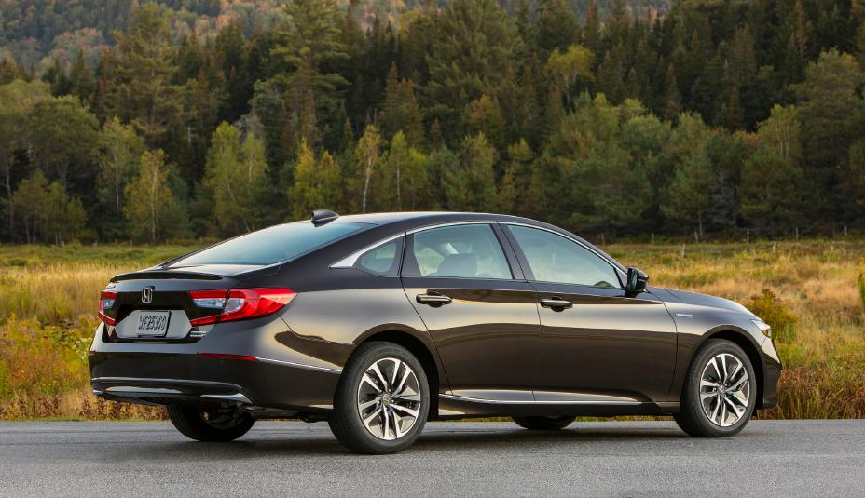
U.S. Sales
2020 Honda Accord Hybrid

Slide 4
American Honda U.S. Auto Sales – Honda Division
 |  | January |  |  | YTD
 |  | 2020 | 2019 | % Change* | 2020 | 2019 | % Change*
 | American Honda Total | 101,625 | 106,139 | -4.3% | 101,625 | 106,139 | -4.3%
 | Honda Division Total | 92,395 | 96,375 | -4.1% | 92,395 | 96,375 | -4.1%
 | Accord | 15,099 | 18,786 | -19.6% | 15,099 | 18,786 | -19.6%
 | Civic | 20,054 | 21,553 | -7.0% | 20,054 | 21,553 | -7.0%
 | Clarity | 475 | 1,271 | -62.6% | 475 | 1,271 | -62.6%
 | Fit | 2,534 | 1,405 | +80.4% | 2,534 | 1,405 | +80.4%
 | Insight | 1,433 | 1,762 | -18.7% | 1,433 | 1,762 | -18.7%
 | CR-V | 26,027 | 29,152 | -10.7% | 26,027 | 29,152 | -10.7%
 | HR-V | 7,457 | 5,974 | +24.8% | 7,457 | 5,974 | +24.8%
 | Odyssey | 5,622 | 5,828 | -3.5% | 5,622 | 5,828 | -3.5%
 | Passport | 2,846 | 126 | +2,158.7% | 2,846 | 126 | +2,158.7%
 | Pilot | 7,765 | 8,556 | -9.2% | 7,765 | 8,556 | -9.2%
 | Ridgeline | 3,083 | 1,962 | +57.1% | 3,083 | 1,962 | +57.1%
Cars
Light Trucks
* Based on year-over-year sales results.
* Based on year-over-year sales results.

Slide 5
American Honda U.S. Auto Sales – Acura Division
 |  | January |  |  | YTD
 |  | 2020 | 2019 | % Change* | 2020 | 2019 | % Change*
 | American Honda Total | 101,625 | 106,139 | -4.3% | 101,625 | 106,139 | -4.3%
 | Acura Division Total | 9,230 | 9,764 | -5.5% | 9,230 | 9,764 | -5.5%
 | ILX | 935 | 805 | +16.1% | 935 | 805 | +16.1%
 | NSX | 9 | 31 | -71.0% | 9 | 31 | -71.0%
 | RLX | 63 | 119 | -47.1% | 63 | 119 | -47.1%
 | TLX | 1,769 | 1,669 | +6.0% | 1,769 | 1,669 | +6.0%
 | MDX | 2,961 | 2,968 | -0.2% | 2,961 | 2,968 | -0.2%
 | RDX | 3,493 | 4,172 | -16.3% | 3,493 | 4,172 | -16.3%
Cars
Light Trucks
* Based on year-over-year sales results.

Slide 6
American Honda Monthly Sales Totals
2020
2019
2018
January 2020 Sales – 101,625

Slide 7
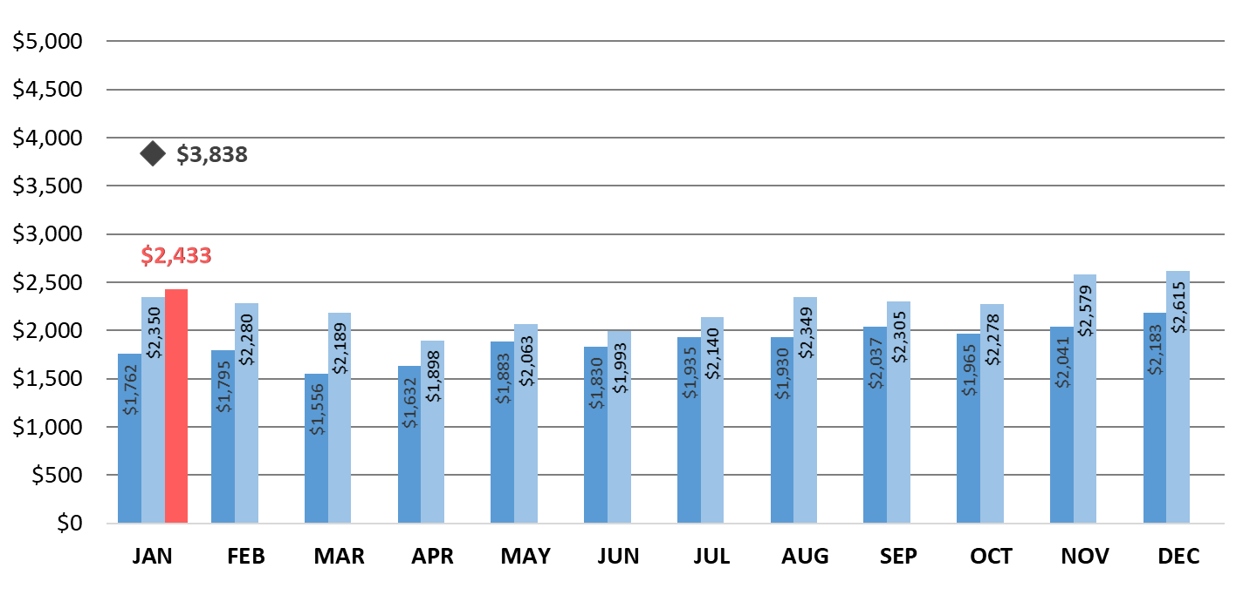
American Honda Auto Incentives
Industry Avg.
2020
2019
2018
American Honda incentives increased compared to January 2019, but were lower than the average from the previous two months (Nov. and Dec. 2019).

Slide 8
Honda U.S. Inventory By N.A. Production Model
Average Inventory
Nov | 65 days
Dec | 58 days
Jan | 76 days
Days Inventory at Dealer
Ideal Level
45-55 Days
Passenger Cars
Light Trucks
This inventory level is determined by dividing dealer inventory at the end of the month by average daily sales.
Bottom line: Overall inventory increased 18 days from December, and has remained above the ideal level since September.
* For internal use only

Slide 9
Honda U.S. Inventory – Passenger Cars
Average Inventory
Nov | 64 days
Dec | 60 days
Jan | 72 days
Days Inventory at Dealer
Ideal Level
45-55 Days
Honda Passenger Cars
Acura Passenger Cars
This inventory level is determined by dividing dealer inventory at the end of the month by average daily sales.
Bottom line: Inventory of each passenger-car model is above the ideal level.
* For internal use only

Slide 10
Honda U.S. Inventory – Light Trucks
Average Inventory
Nov | 66 days
Dec | 57 days
Jan | 78 days
Days Inventory at Dealer
Ideal Level
45-55 Days
Honda Light Trucks
Acura Light Trucks
This inventory level is determined by dividing dealer inventory at the end of the month by average daily sales.
Bottom line: Overall light-truck inventory jumped by 21 days compared to December, with only inventory of the Ridgeline at or below the ideal level.
* For internal use only

Slide 11
U.S. Power Equipment Sales
Power Equipment sales decreased 28% compared to 2019, with total unit sales of 249,927. In January, tiller sales increased 99%, snow blowers sales increased 41% and lawn mower sales increased 86%.
Honda Marine reported 879 in sales for January, a decline of 19%; portable outboards were down 23% and large outboards were down 17% compared to last year.

Slide 12
U.S. Powersports Sales
“Purchase decisions continue to be influenced by the legendary quality, greater value and ease of use of our power products, and our focus remains on helping people get things done in 2020 and beyond.”
Will Walton
Vice President
Honda Power Equipment Division

Slide 13
U.S. Powersports Sales
Powersports reported January sales of 11,219 units, a 32% gain and its best January in 10 years.
Side-by-Side sales were up 46%
ATV sales increased 16%
Off-road increased 73%
On-road decreased 14%
2020 Honda CRF110F

Slide 14
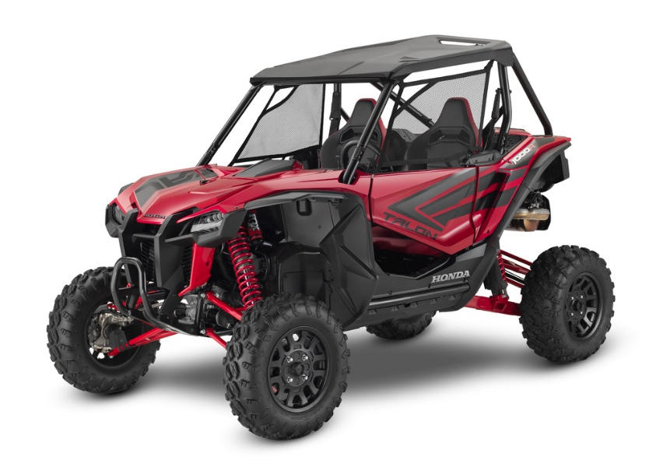
U.S. Powersports Sales
“Honda's brand awareness is front and center after receiving many press ‘Best of’ awards in 2019. As we enter a new decade, our focus remains on the customer. By producing products of the highest quality yet at a reasonable price, we are aligned with Honda's commitment to be a company that society wants to exist.”
Chuck Boderman,
Powersports Division
Business Unit Head
2020 Honda Talon 1000R

Slide 15
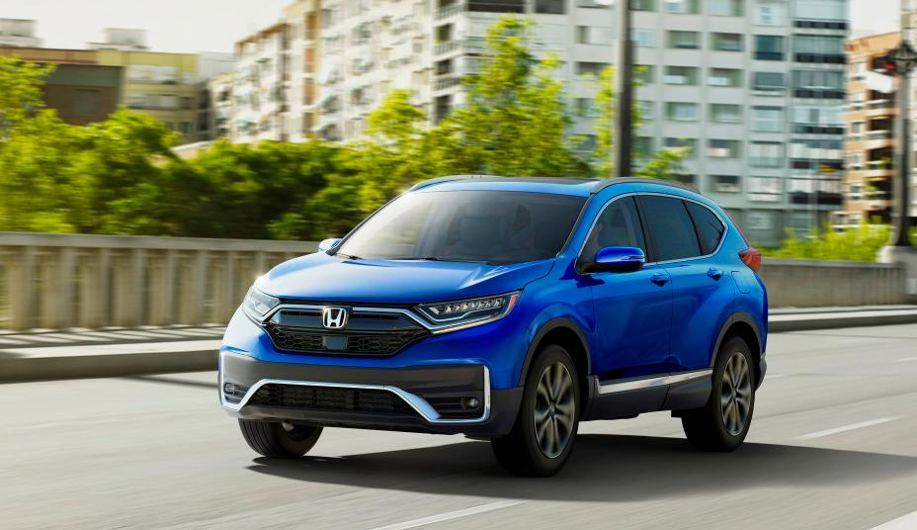
Canada Sales
2020 Honda CR-V Hybrid

Slide 16
Honda Canada Auto Sales – Honda Division
 |  | January |  |  | YTD
 |  | 2020 | 2019 | % Change* | 2020 | 2019 | % Change*
 | Honda Canada Total | 9,656 | 10,793 | -10.5% | 9,656 | 10,793 | -10.5%
 | Honda Division Total | 8,912 | 9,886 | -9.9% | 8,912 | 9,886 | -9.9%
 | Accord | 451 | 580 | -22.2% | 451 | 580 | -22.2%
 | Civic | 3,298 | 3,661 | -9.9% | 3,298 | 3,661 | -9.9%
 | Clarity | 20 | 15 | +33.3% | 20 | 15 | +33.3%
 | Fit | 128 | 419 | -69.5% | 128 | 419 | -69.5%
 | Insight | 46 | 20 | +130.0% | 46 | 20 | +130.0%
 | CR-V | 2,825 | 2,878 | -1.8% | 2,825 | 2,878 | -1.8%
 | HR-V | 637 | 970 | -34.3% | 637 | 970 | -34.3%
 | Odyssey | 452 | 568 | -20.4% | 452 | 568 | -20.4%
 | Passport | 175 | --- | --- | 175 | --- | ---
 | Pilot | 643 | 528 | +21.8% | 643 | 528 | +21.8%
 | Ridgeline | 237 | 247 | -4.0% | 237 | 247 | -4.0%
Cars
Light Trucks
* Based on year-over-year sales results.

Slide 17
Honda Canada Auto Sales – Acura Division
 |  | January |  |  | YTD
 |  | 2020 | 2019 | % Change* | 2020 | 2019 | % Change*
 | Honda Canada Total | 9,656 | 10,793 | -10.5% | 9,656 | 10,793 | -10.5%
 | Acura Division Total | 744 | 907 | -18.0% | 744 | 907 | -18.0%
 | ILX | 37 | 86 | -57.0% | 37 | 86 | -57.0%
 | NSX | 0 | 0 | -- | 0 | 0 | --
 | RLX | 4 | 5 | -20.0% | 4 | 5 | -20.0%
 | TLX | 134 | 176 | -23.9% | 134 | 176 | -23.9%
 | MDX | 151 | 167 | -9.6% | 151 | 167 | -9.6%
 | RDX | 418 | 473 | -11.6% | 418 | 473 | -11.6%
Cars
Light Trucks
* Based on year-over-year sales results.

Slide 18
Honda Canada Inventory
By N.A. Production Model
Average Inventory
Nov | 68 days
Dec | 111 days
Jan | 148 days
Days Inventory at Dealer
Ideal Level
60-70 Days
Passenger Cars
Light Trucks
Honda Canada utilizes data based on last 60-days of sales to calculate inventory
Bottom line: Overall inventory is now more than double the ideal level.
* For internal use only

Slide 19
Honda Canada Passenger Car Inventory By N.A. Production Model
Days Inventory at Dealer
Ideal Level
60-70 Days
Honda Passenger Cars
Acura Passenger Cars
Honda Canada utilizes data based on last 60-days of sales to calculate inventory
Bottom line: Inventory for every passenger vehicle is well above the ideal level.
* For internal use only

Slide 20
Honda Canada Light Truck Inventory By N.A. Production Model
Days Inventory at Dealer
Ideal Level
60-70 Days
Honda Light Trucks
Acura Light Truck
Honda Canada utilizes data based on last 60-days of sales to calculate inventory
Bottom line: RDX is the only light-truck model at or below the ideal level.
* For internal use only

Slide 21
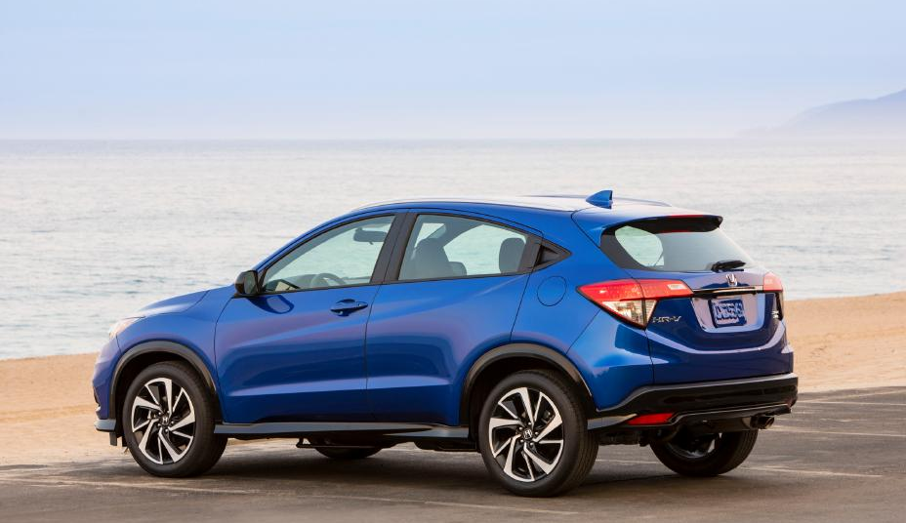
Mexico Sales
2020 Honda HR-V

Slide 22
Honda de Mexico Auto Sales – Honda Division
 |  | January |  |  | YTD
 |  | 2020 | 2019 | % Change* | 2020 | 2019 | % Change*
 | Honda de Mexico Total | 6,755 | 7,106 | -4.9% | 6,755 | 7,106 | -4.9%
 | Honda Division Total | 6,645 | 6,948 | -4.4% | 6,645 | 6,948 | -4.4%
 | Accord | 195 | 279 | -30.1% | 195 | 279 | -30.1%
 | City | 951 | 1,118 | -14.9% | 951 | 1,118 | -14.9%
 | Civic | 693 | 1,264 | -45.2% | 693 | 1,264 | -45.2%
 | Fit | 300 | 242 | +24.0% | 300 | 242 | +24.0%
 | Insight | 57 | 27 | +111.1% | 57 | 27 | +111.1%
 | BR-V | 557 | 594 | -6.2% | 557 | 594 | -6.2%
 | CR-V | 2,095 | 1,761 | +19.0% | 2,095 | 1,761 | +19.0%
 | HR-V | 1,545 | 1,362 | +13.4% | 1,545 | 1,362 | +13.4%
 | Odyssey | 147 | 177 | -16.9% | 147 | 177 | -16.9%
 | Pilot | 105 | 124 | -15.3% | 105 | 124 | -15.3%
Cars
Cars
Light Trucks
Light trucks
* Based on year-over-year sales results.
* Based on year-over-year sales results.

Slide 23
Honda de Mexico Auto Sales – Acura Division
 |  | January |  |  | YTD
 |  | 2020 | 2019 | % Change* | 2020 | 2019 | % Change*
 | Honda de Mexico Total | 6,755 | 7,106 | -4.9% | 6,755 | 7,106 | -4.9%
 | Acura Division Total | 110 | 158 | -30.4% | 110 | 158 | -30.4%
 | ILX | 6 | 7 | -14.3% | 6 | 7 | -14.3%
 | NSX | --- | 1 | --- | --- | 1 | ---
 | TLX | 7 | 21 | -66.7% | 7 | 21 | -66.7%
 | MDX | 19 | 21 | -9.5% | 19 | 21 | -9.5%
 | RDX | 78 | 109 | -28.4% | 78 | 109 | -28.4%
Cars
Cars
Light Trucks
Light trucks
* Based on year-over-year sales results.

