Slide 1
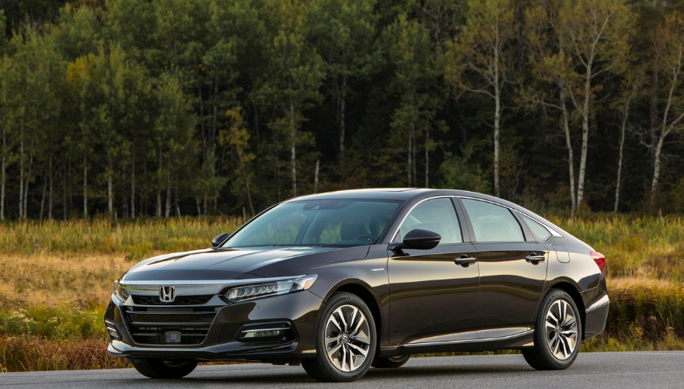
Sales and Production Update
2020: April
2020 Accord Hybrid

Slide 2
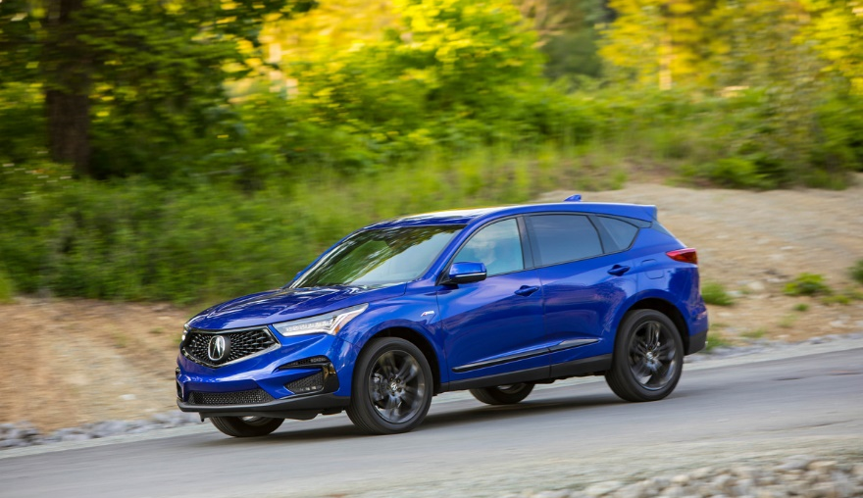
U.S. Sales
2020 Acura RDX

Slide 3
American Honda U.S. Auto Sales – Honda Division
 |  | April |  |  | YTD
 |  | 2020 | 2019 | % Change* | 2020 | 2019 | % Change*
 | American Honda Total | 57,751 | 125,775 | -54.1% | 356,536 | 495,562 | -28.1%
 | Honda Division Total | 52,705 | 114,088 | -53.8% | 322,958 | 447,490 | -27.8%
 | Accord | 8,851 | 19,239 | -54.0% | 55,976 | 83,650 | -33.1%
 | Civic | 13,410 | 28,436 | -52.8% | 77,354 | 106,621 | -27.4%
 | Clarity | 90 | 1,079 | -91.7% | 1,345 | 5,047 | -73.4%
 | Fit | 1,187 | 3,247 | -63.4% | 8,366 | 9,635 | -13.2%
 | Insight | 511 | 2,028 | -74.8% | 4,414 | 7,528 | -41.4%
 | CR-V | 12,201 | 28,344 | -57.0% | 83,387 | 115,624 | -27.9%
 | HR-V | 2,906 | 7,272 | -60.0% | 22,320 | 28,921 | -22.8%
 | Odyssey | 3,933 | 7,482 | -47.4% | 20,323 | 28,779 | -29.4%
 | Passport | 1,594 | 2,907 | -45.2% | 9,427 | 7,721 | +22.1%
 | Pilot | 6,562 | 11,399 | -42.4% | 30,460 | 44,356 | -31.3%
 | Ridgeline | 1,460 | 2,654 | -45.0% | 9,585 | 9,606 | -0.2%
Cars
Light Trucks
* Based on year-over-year sales results.
* Based on year-over-year sales results.

Slide 4
American Honda U.S. Auto Sales – Acura Division
 |  | April |  |  | YTD
 |  | 2020 | 2019 | % Change* | 2020 | 2019 | % Change*
 | American Honda Total | 57,751 | 125,775 | -54.1% | 356,536 | 495,562 | -28.1%
 | Acura Division Total | 5,046 | 11,687 | -56.8% | 33,578 | 48,072 | -30.2%
 | ILX | 506 | 1,152 | -56.1% | 3,247 | 4,293 | -24.4%
 | NSX | 5 | 23 | -78.3% | 39 | 102 | -61.8%
 | RLX | 26 | 151 | -82.8% | 205 | 532 | -61.5%
 | TLX | 1,024 | 2,096 | -51.1% | 6,508 | 9,125 | -28.7%
 | MDX | 1,725 | 3,339 | -48.3% | 10,666 | 14,122 | -24.5%
 | RDX | 1,760 | 4,926 | -64.3% | 12,913 | 19,898 | -35.1%
Cars
Light Trucks
* Based on year-over-year sales results.

Slide 5
American Honda Monthly Sales Totals
2020
2019
2018
April 2020 Sales – 57,751

Slide 6
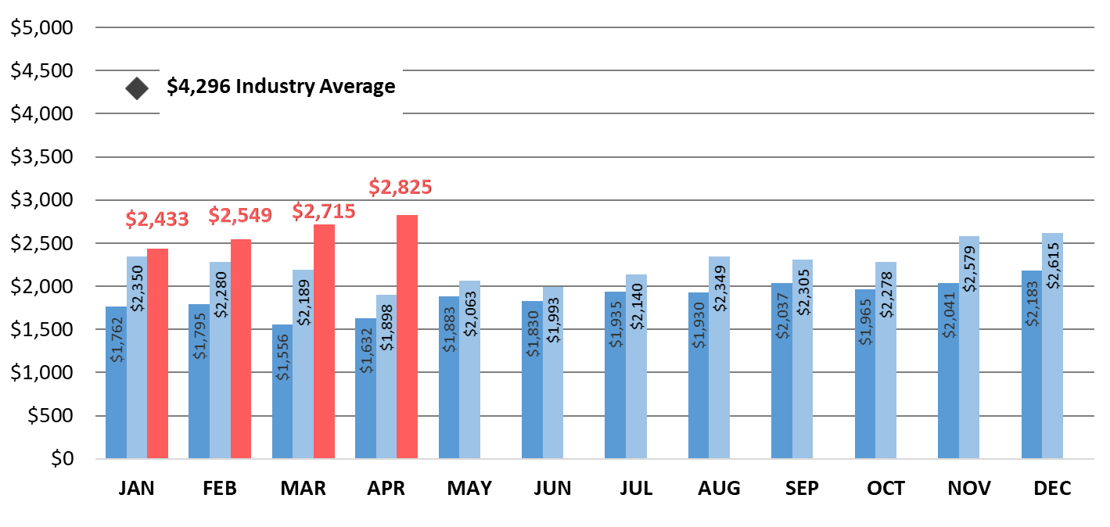
American Honda Auto Incentives
2020
2019
2018
American Honda incentives increased 4.1% from March 2020 and 48.8% from April 2019.

Slide 7
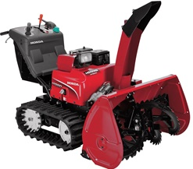
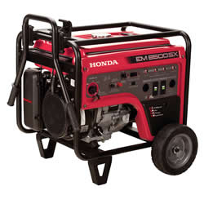
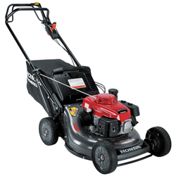
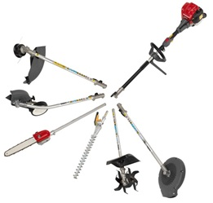
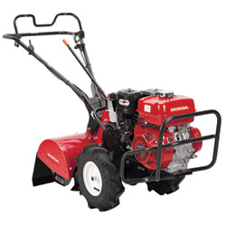
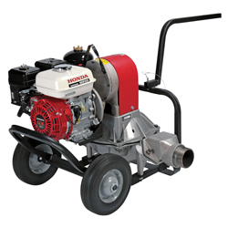
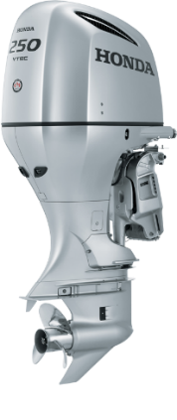

Slide 8
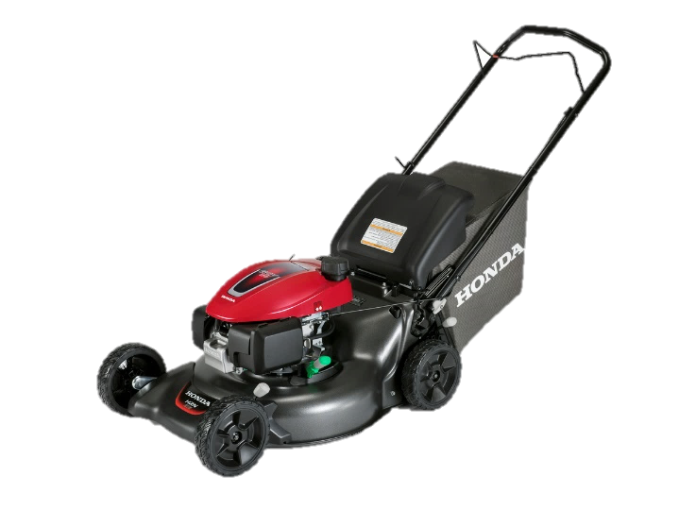
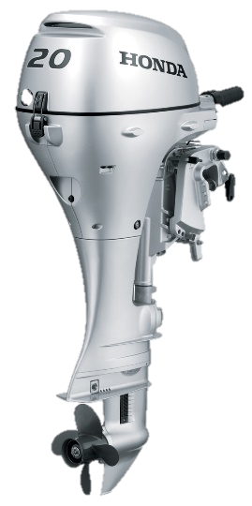
U.S. Power Equipment Sales
Power Equipment sales decreased 32% in April compared to 2019, with total unit sales of 142,344.
Honda Marine reported sales of 864 units for April, representing a decline of 34%; portable outboards were down 29% and large outboards were down 41% compared to last year.
HRN216VYA
Lawn Mower
Honda BF20

Slide 9
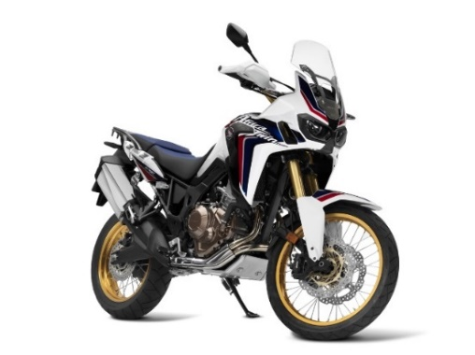
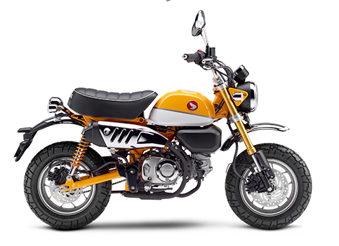
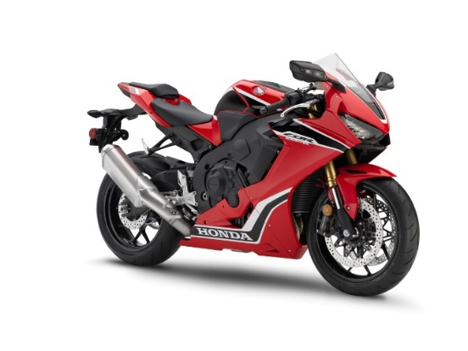
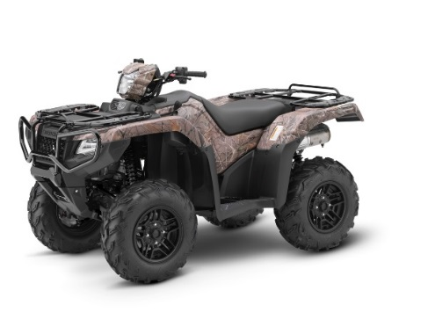
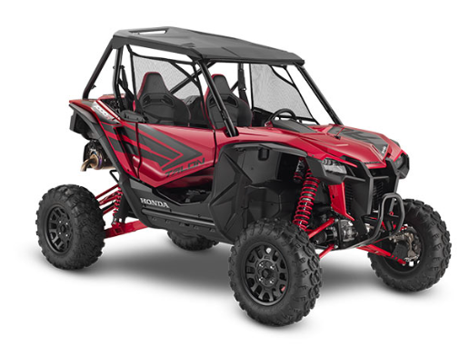
Powersports Sales Results

Slide 10
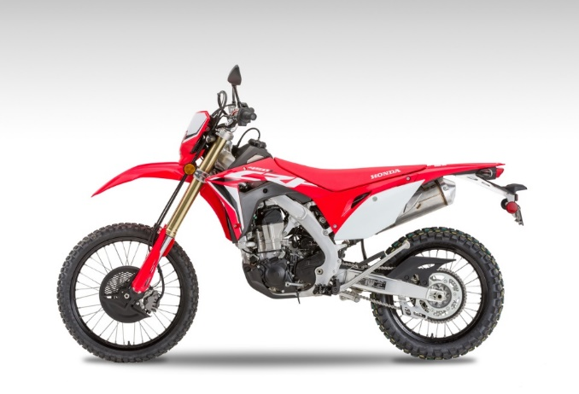
U.S. Powersports Sales
Powersports reported April sales of 24,841 units, a 13% increase vs. 2019.
On-road motorcycle sales declined 36%
Side-by-Side sales were up 21%
Off-road increased 77%
2020 Honda CRF450L

Slide 11
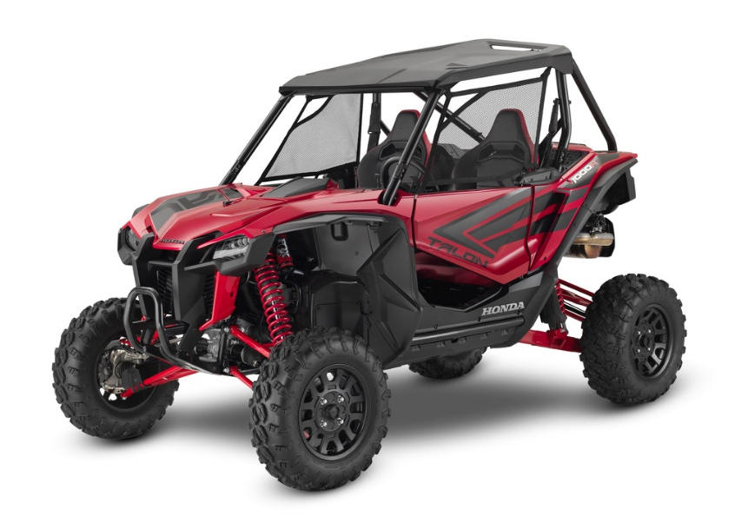
U.S. Powersports Sales
“Our dealers continue to show innovative and determined efforts to comply with state orders and enforce social distancing standards. With this impressive commitment they have adapted to challenges quickly, with many utilizing our new remote delivery option to be able to continue to serve
our customers' needs.”
Chuck Boderman,
Powersports Division
Business Unit Head
2020 Honda Talon 1000R

Slide 12
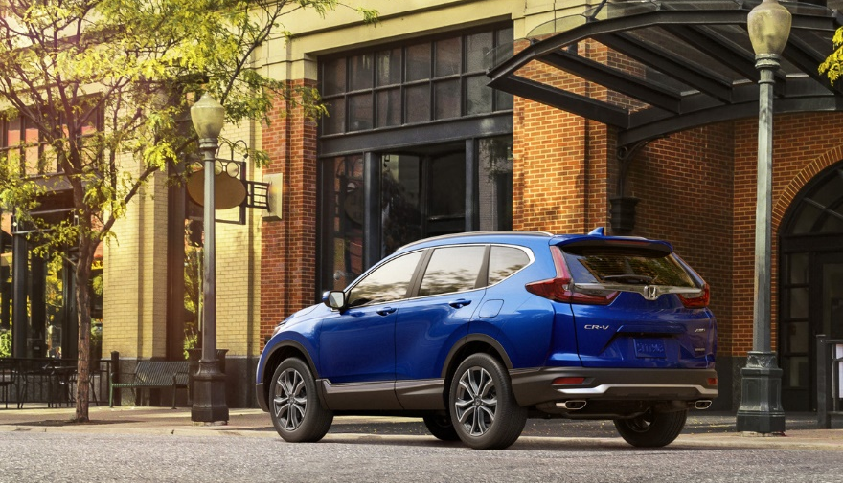
Canada Sales
2020 Honda CR-V

Slide 13
Honda Canada Auto Sales – Honda Division
 |  | April |  |  | YTD
 |  | 2020 | 2019 | % Change* | 2020 | 2019 | % Change*
 | Honda Canada Total | 2,749 | 16,685 | -83.5% | 31,769 | 58,974 | -46.1%
 | Honda Division Total | 2,446 | 14,591 | -83.2% | 28,987 | 53,193 | -45.5%
 | Accord | 100 | 1,006 | -90.1% | 1,392 | 3,312 | -58.0%
 | Civic | 923 | 5,234 | -82.4% | 9,939 | 19,370 | -48.7%
 | Clarity | 26 | 64 | -59.4% | 283 | 301 | -6.0%
 | Fit | 41 | 421 | -90.3% | 385 | 1,536 | -74.9%
 | Insight | 7 | 30 | -76.7% | 130 | 130 | EVEN
 | CR-V | 755 | 4,497 | -83.2% | 9,937 | 17,518 | -43.3%
 | HR-V | 142 | 1,048 | -86.5% | 2,022 | 3,725 | -45.7%
 | Odyssey | 111 | 1,013 | -89.0% | 1,365 | 2,916 | -53.2%
 | Passport | 53 | 295 | -82.0% | 675 | 564 | +19.7%
 | Pilot | 196 | 663 | -70.4% | 1,991 | 2,769 | -28.1%
 | Ridgeline | 92 | 320 | -71.3% | 868 | 1,052 | -17.5%
Cars
Light Trucks
* Based on year-over-year sales results.

Slide 14
Honda Canada Auto Sales – Acura Division
 |  | April |  |  | YTD
 |  | 2020 | 2019 | % Change* | 2020 | 2019 | % Change*
 | Honda Canada Total | 2,749 | 16,685 | -83.5% | 31,769 | 58,974 | -46.1%
 | Acura Division Total | 303 | 2,094 | -85.5% | 2,782 | 5,781 | -51.9%
 | ILX | 14 | 286 | -95.1 | 125 | 646 | -80.7%
 | NSX | 2 | 2 | EVEN | 4 | 7 | -42.9%
 | RLX | 0 | 4 | --- | 8 | 17 | -52.9%
 | TLX | 77 | 487 | -84.2% | 568 | 1,407 | -59.6%
 | MDX | 54 | 551 | -90.2% | 538 | 1,422 | -62.2%
 | RDX | 156 | 764 | -79.6% | 1,539 | 2,282 | -32.6%
Cars
Light Trucks
* Based on year-over-year sales results.

Slide 15
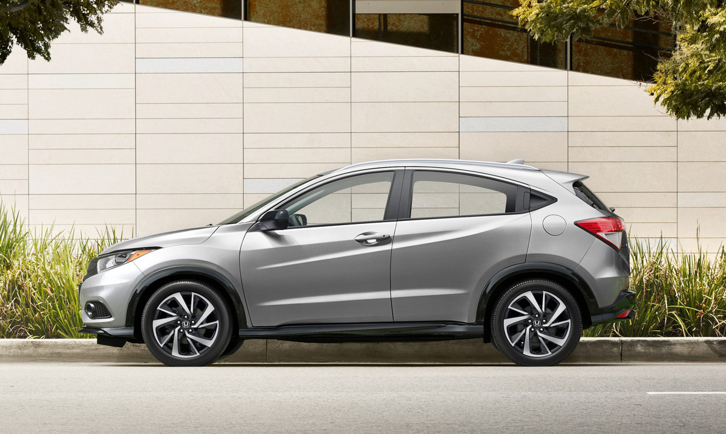
Mexico Sales
2020 Honda HR-V Touring

Slide 16
Honda de Mexico Auto Sales – Honda Division
 |  | April |  |  | YTD
 |  | 2020 | 2019 | % Change* | 2020 | 2019 | % Change*
 | Honda de Mexico Total | 1,219 | 5,264 | -76.8% | 17,409 | 26,801 | -35.0%
 | Honda Division Total | 1,206 | 5,121 | -76.4% | 17,089 | 26,127 | -34.5%
 | Accord | 70 | 206 | -66.0% | 608 | 1,035 | -41.3%
 | City | 279 | 705 | -60.4% | 2,529 | 3,926 | -35.6%
 | Civic | 198 | 588 | -66.3% | 2,191 | 3,494 | -37.3%
 | Fit | 46 | 235 | -80.4% | 731 | 1,066 | -31.4%
 | Insight | 11 | 124 | -91.1% | 151 | 213 | -29.1%
 | BR-V | 77 | 325 | -76.3% | 1,452 | 2,066 | -29.7%
 | CR-V | 190 | 1,383 | -86.3% | 4,615 | 7,080 | -34.8%
 | HR-V | 289 | 1,269 | -77.2% | 4,092 | 5,901 | -30.7%
 | Odyssey | 33 | 158 | -79.1% | 446 | 844 | -47.2%
 | Pilot | 13 | 128 | -89.8% | 274 | 502 | -45.4%
Cars
Cars
Light Trucks
Light trucks
* Based on year-over-year sales results.
* Based on year-over-year sales results.

Slide 17
Honda de Mexico Auto Sales – Acura Division
 |  | April |  |  | YTD
 |  | 2020 | 2019 | % Change* | 2020 | 2019 | % Change*
 | Honda de Mexico Total | 1,219 | 5,264 | -76.8% | 17,409 | 26,801 | -35.0%
 | Acura Division Total | 13 | 143 | -90.9% | 320 | 674 | -52.5%
 | ILX | 1 | 27 | -96.3% | 19 | 48 | -60.4%
 | NSX | 0 | 0 | EVEN | 1 | 4 | -75.0%
 | TLX | 0 | 7 | --- | 18 | 70 | -74.3%
 | MDX | 1 | 25 | -96.0% | 57 | 125 | -54.4%
 | RDX | 11 | 84 | -86.9% | 225 | 427 | -47.3%
Cars
Cars
Light Trucks
Light trucks
* Based on year-over-year sales results.

