Slide 1
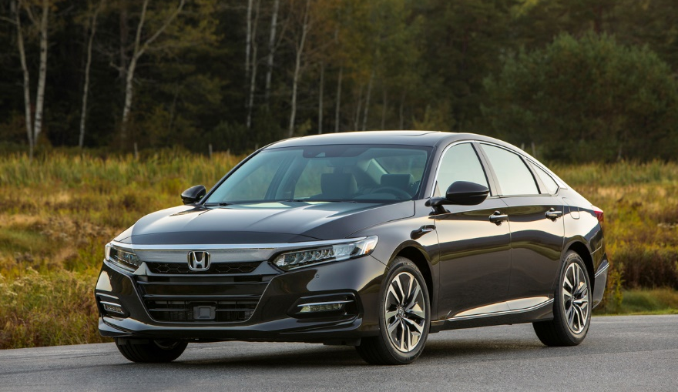
Sales and Production Update
June 2020
2020 Honda Accord Hybrid

Slide 2
North American Auto Production
 |  | 2020 | CY base | June '20 | June '19 | CHG% | 2020 | 2019 | CHG%
 |  |  | MAP | 25,525 | 36,584 | -30.2% | 119,847 | 222,442 | -46.1%
 |  |  | ELP | 17,821 | 18,927 | -5.8% | 78,901 | 119,269 | -33.8%
 |  |  | PMC | 74 | 60 | +23.3% | 247 | 194 | +27.3%
 |  | HAM TTL |  | 43,420 | 55,571 | -21.9% | 198,995 | 341,905 | -41.8%
 |  | HMA |  | 25,176 | 30,646 | -17.8% | 107,493 | 186,353 | -42.3%
 |  | HMIN |  | 18,220 | 20,050 | -9.1% | 80,396 | 124,378 | -35.4%
 |  |  | USA TTL | 86,816 | 106,267 | -18.3% | 386,884 | 652,636 | -40.7%
 |  |  | Plant 1 | 17,380 | 16,143 | +7.7% | 69,332 | 101,712 | -31.8%
 |  |  | Plant 2 | 15,620 | 17,213 | -9.3% | 70,704 | 107,838 | -34.4%
 |  | HCM TTL |  | 32,999 | 33,356 | -1.1% | 140,036 | 209,550 | -33.2%
 |  |  | Guadalajara | 0 | 3,168 | -100.0% | 0 | 21,713 | -100.0%
 |  |  | Celaya | 12,890 | 14,190 | -9.2% | 49,419 | 90,453 | -45.4%
 |  | HDM |  | 12,890 | 17,358 | -25.7% | 49,419 | 112,166 | -55.9%
 |  |  | N.A. TTL | 132,705 | 156,981 | -15.5% | 576,339 | 974,352 | -40.8%
Bottom line: North America sets a new production record for the month of October, breaking the previous record set in 2013.
Bottom line: North American and U.S. auto production fell compared to June 2019 as overall production continues to increase toward normal daily capacity.

Slide 3
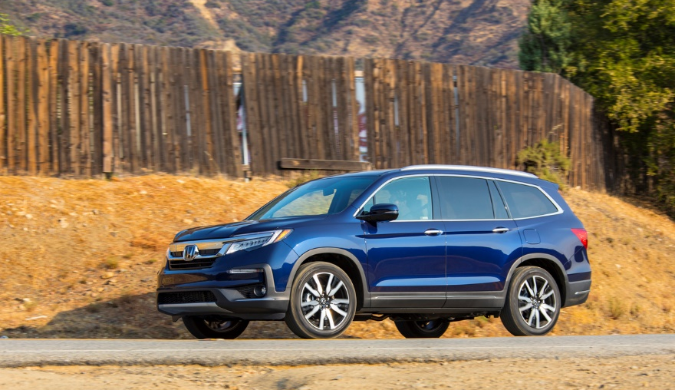
U.S. Sales
2020 Honda Pilot Elite

Slide 4
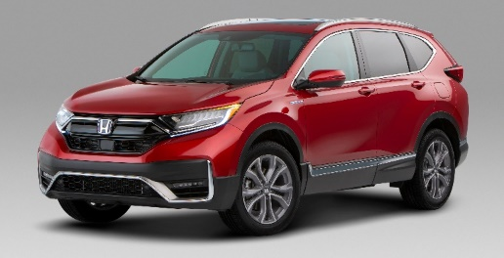
2020 U.S. Sales & Market Share
U.S. auto sales fell sharply in the second quarter as the industry provided its first detailed look at the toll on consumer demand exacted by the coronavirus.
Pent-up consumer demand, easing government restrictions on business and household activity, and record incentives all provided a tailwind for the industry in June.
2020 Honda CR-V Hybrid
Sales
 | Industry Total
Year-to-date Total Sales % Change/2019 | 6,432,486 | 592,287 | 1,110,824 | 950,199 | 893,776 | 813,854 | 434,934 | 280,137
23.5
23.8
21.4
23.4
22.4
25.8
39.3
18.4
Year-to-date percentages
2020 | 9.2 | 17.3 | 14.8 | 13.9 | 12.7 | 6.8 | 4.4
2019 | 9.2 | 16.8 | 14.8 | 13.7 | 13.0 | 8.5 | 4.1
Market Share
Source: Automotive News

Slide 5
American Honda U.S. Auto Sales – Honda Division
 |  | June |  |  | YTD
 |  | 2020 | 2019 | % Change* | 2020 | 2019 | % Change*
 | American Honda Total | 114,774 | 135,901 | -15.5% | 592,287 | 776,995 | -23.8%
 | Honda Division Total | 102,703 | 123,753 | -17.0% | 536,297 | 703,228 | -23.7%
 | Accord | 15,409 | 21,893 | -29.6% | 88,754 | 129,435 | -31.4%
 | Civic | 23,260 | 29,751 | -21.8% | 127,858 | 169,172 | -24.4%
 | Clarity | 187 | 1,092 | -82.9% | 1,780 | 7,045 | -74.7%
 | Fit | 2,923 | 3,603 | -18.9% | 13,887 | 17,156 | -19.1%
 | Insight | 1,423 | 2,367 | -39.9% | 6,964 | 12,548 | -44.5%
 | CR-V | 26,488 | 30,427 | -12.9% | 138,898 | 176,944 | -21.5%
 | HR-V | 7,512 | 7,693 | -2.4% | 36,895 | 45,179 | -18.3%
 | Odyssey | 7,946 | 9,202 | -13.6% | 35,917 | 47,500 | -24.4%
 | Passport | 3,060 | 3,385 | -9.6% | 16,023 | 14,540 | +10.2%
 | Pilot | 12,128 | 11,579 | +4.7% | 54,815 | 68,452 | -19.9%
 | Ridgeline | 2,367 | 2,761 | -14.3% | 14,505 | 15,255 | -4.9%
Cars
Light Trucks
* Based on year-over-year sales results.
* Based on year-over-year sales results.

Slide 6
American Honda U.S. Auto Sales – Acura Division
 |  | June |  |  | YTD
 |  | 2020 | 2019 | % Change* | 2020 | 2019 | % Change*
 | American Honda Total | 114,774 | 135,901 | -15.5% | 592,287 | 776,995 | -23.8%
 | Acura Division Total | 12,071 | 12,148 | -0.6% | 55,990 | 73,767 | -24.1%
 | ILX | 1,109 | 1,312 | -15.5% | 5,395 | 6,956 | -22.4%
 | NSX | 10 | 19 | -47.4% | 55 | 151 | -63.6%
 | RLX | 126 | 50 | +152.0% | 402 | 673 | -40.3%
 | TLX | 1,439 | 1,812 | -20.6% | 9,414 | 13,172 | -28.5%
 | MDX | 3,977 | 4,087 | -2.7% | 17,974 | 22,634 | -20.6%
 | RDX | 5,410 | 4,868 | +11.1% | 22,750 | 30,181 | -24.6%
Cars
Light Trucks
* Based on year-over-year sales results.

Slide 7
American Honda Monthly Sales Totals
2020
2019
2018
June 2020 Sales – 114,774

Slide 8
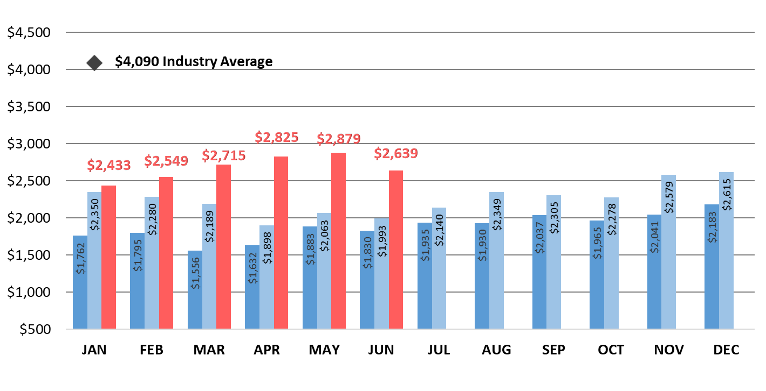
American Honda Auto Incentives
2020
2019
2018
American Honda incentives decreased 8.3% from May 2020 and increased 32.4% from June 2019.

Slide 9
Honda U.S. Inventory By N.A. Production Model
Average Inventory
April | 152 days
May | 55 days
June | 49 days
Days Inventory at Dealer
Ideal Level
45-55 Days
Passenger Cars
Light Trucks
This inventory level is determined by dividing dealer inventory at the end of the month by average daily sales.
Bottom line: Inventory for five models is now below the ideal level, with overall inventory falling more than 100 days since April.
* For internal use only

Slide 10
Honda U.S. Inventory – Passenger Cars
Average Inventory
April | 134 days
May | 51 days
June | 49 days
Days Inventory at Dealer
Ideal Level
45-55 Days
Honda Passenger Cars
Acura Passenger Cars
This inventory level is determined by dividing dealer inventory at the end of the month by average daily sales.
Bottom line: ILX and TLX join the Civic as models with inventory below the ideal level.
* For internal use only

Slide 11
Honda U.S. Inventory – Light Trucks
Average Inventory
April | 165 days
May | 58 days
June | 49 days
Days Inventory at Dealer
Ideal Level
45-55 Days
Honda Light Trucks
Acura Light Trucks
This inventory level is determined by dividing dealer inventory at the end of the month by average daily sales.
Bottom line: Overall light-truck inventory is now within the ideal level, with CR-V and RDX inventory below the ideal level.
* For internal use only

Slide 12
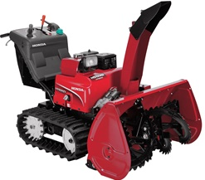
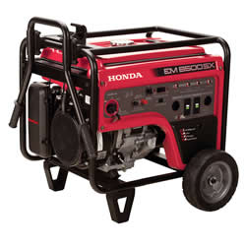
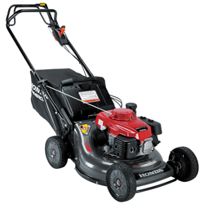
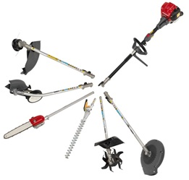
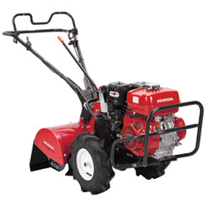
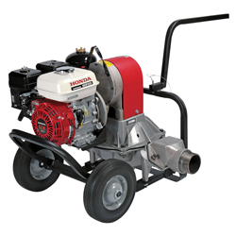
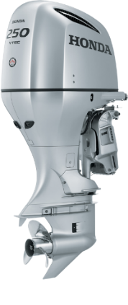

Slide 13
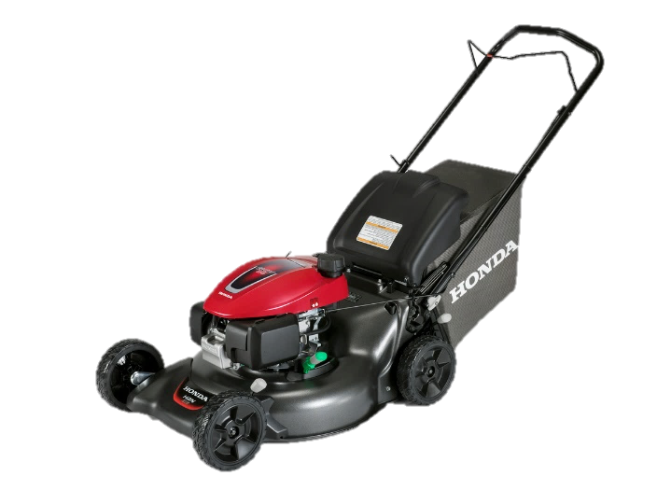
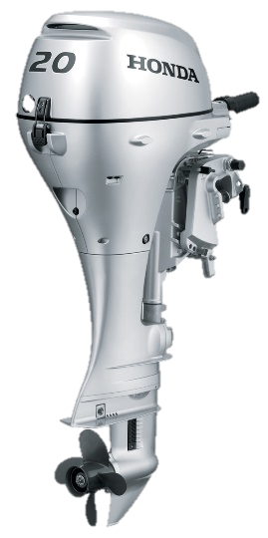
U.S. Power Equipment Sales
Power Equipment sales increased 22% in June compared to 2019, with total unit sales of 182,094.
Lawn mower sales up 4%
Generator sales up 44%
Snow blower sales up 526%
Trimmer sales up 67%
Honda Marine reported sales of 2,698 units for June, representing an increase of 127%
HRN216VYA
Lawn Mower
Honda BF20

Slide 14
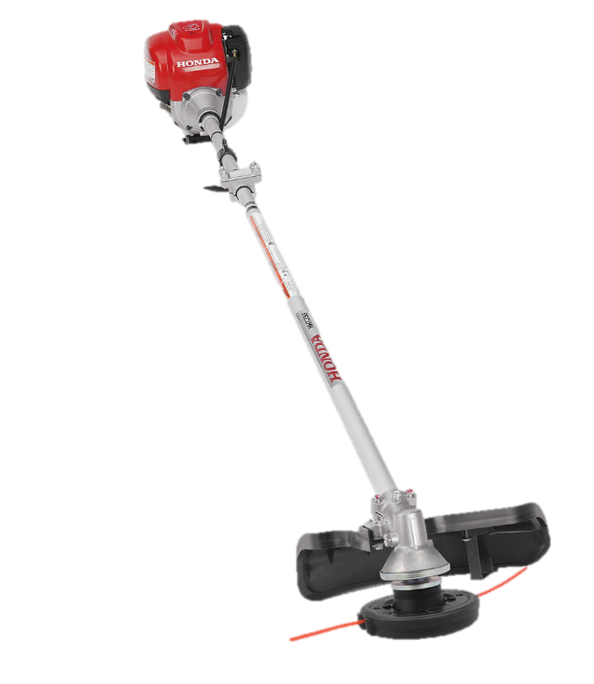
U.S. Power Equipment Sales
“Honda Power Equipment concluded June with demonstrably stronger sales across our operating units, experiencing extraordinary gains for certain outdoor power products, marine outboards, and general-purpose engine lines. We’re quickly approaching the peak of our summer season in the U.S., and consumers are turning to Honda products, embracing lawn and garden activities and enjoying outdoor spaces—particularly the waterways.
My thanks to all of our partners for your hard work and
continued support.”
Will Walton
Vice President
Honda Power Equipment Division
HHT35SUKA
Trimmer

Slide 15
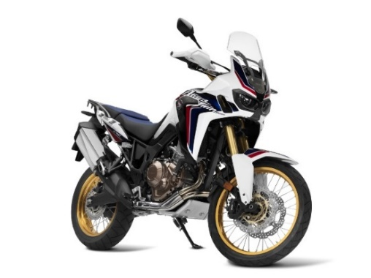
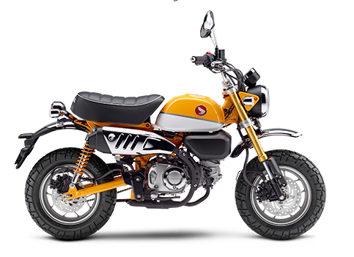
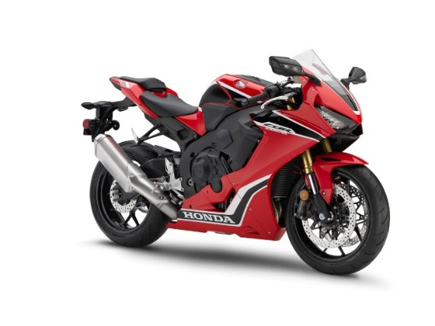
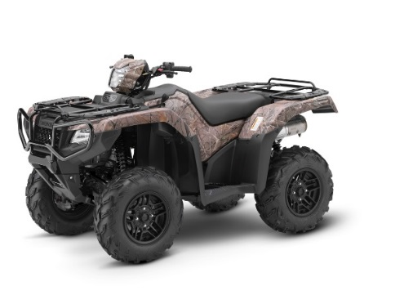
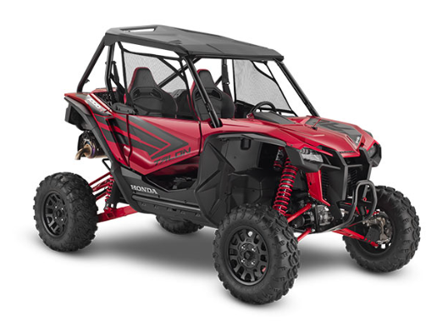
Powersports Sales Results

Slide 16
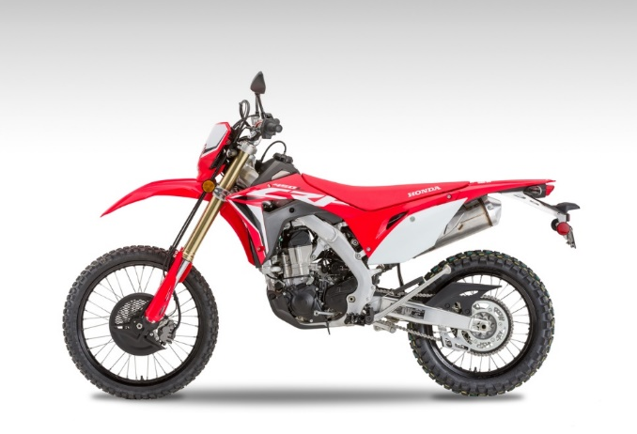
U.S. Powersports Sales
Powersports reported June sales of 29,904, up 69% versus June 2019.
On-road sales increased 37%
Side-by-Side sales were up 114%
Off-road increased 44%
ATV sales grew 80%
2020 Honda CRF450L

Slide 17
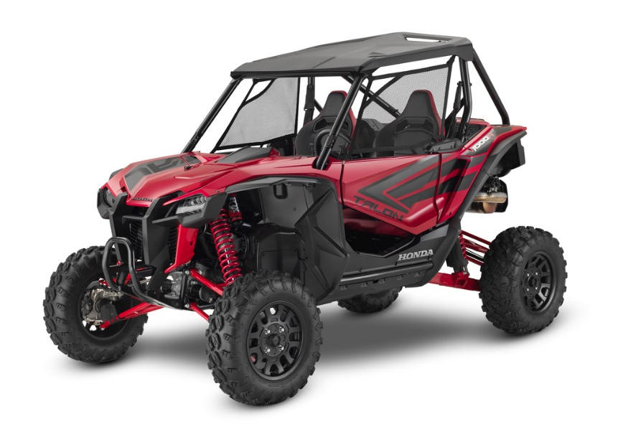
U.S. Powersports Sales
“As we finish the first quarter of the new fiscal year, we remain optimistic that strong sales trends for Honda Powersports products will continue. This has been a time unlike any other in our industry, and we applaud our dealers for adapting and making necessary changes to the way we do business as we move through this period to better times ahead.”
Chuck Boderman
Powersports Division
Business Unit Head
2020 Honda Talon 1000R

Slide 18
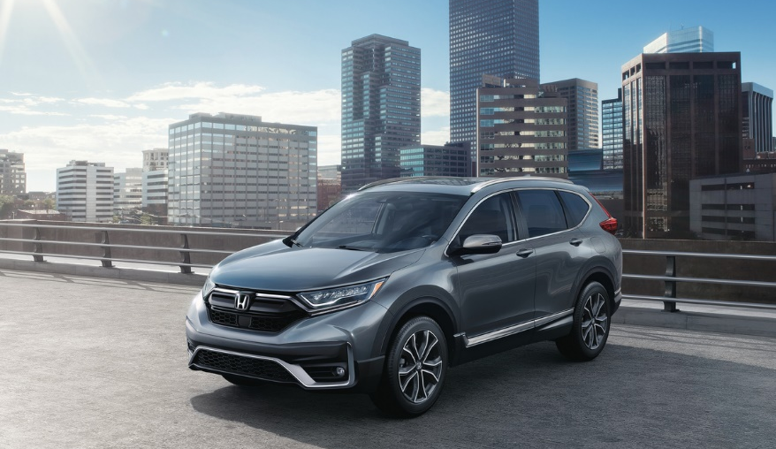
Canada Sales
2020 Honda CR-V

Slide 19
Honda Canada Auto Sales – Honda Division
 |  | June |  |  | YTD
 |  | 2020 | 2019 | % Change* | 2020 | 2019 | % Change*
 | Honda Canada Total | 16,386 | 16,939 | -3.3% | 58,806 | 96,600 | -39.1%
 | Honda Division Total | 14,613 | 15,278 | -4.4% | 53,056 | 87,298 | -39.2%
 | Accord | 675 | 1,082 | -37.6% | 2,548 | 5,837 | -56.3%
 | Civic | 5,095 | 6,065 | -16.0% | 18,193 | 32,398 | -43.8%
 | Clarity | 88 | 191 | -53.9% | 442 | 713 | -38.0%
 | Fit | 170 | 273 | -37.7% | 683 | 2,313 | -70.5%
 | Insight | 22 | 56 | -60.7% | 174 | 252 | -31.0%
 | CR-V | 4,632 | 4,254 | +8.9% | 17,661 | 27,581 | -36.0%
 | HR-V | 1,355 | 1,286 | +5.4% | 4,155 | 6,363 | -34.7%
 | Odyssey | 760 | 885 | -14.1% | 2,534 | 4,840 | -47.6%
 | Passport | 423 | 282 | +50.0% | 1,390 | 1,203 | +15.5%
 | Pilot | 1,060 | 594 | +78.5% | 3,788 | 4,071 | -7.0%
 | Ridgeline | 333 | 310 | +7.4% | 1,488 | 1,727 | -13.8%
Cars
Light Trucks
* Based on year-over-year sales results.

Slide 20
Honda Canada Auto Sales – Acura Division
 |  | June |  |  | YTD
 |  | 2020 | 2019 | % Change* | 2020 | 2019 | % Change*
 | Honda Canada Total | 16,386 | 16,939 | -3.3% | 58,806 | 96,600 | -39.1%
 | Acura Division Total | 1,773 | 1,661 | +6.7% | 5,750 | 9,302 | -38.2%
 | ILX | 77 | 177 | -56.5% | 257 | 1,032 | -75.1%
 | NSX | 1 | 4 | -75.0% | 9 | 17 | -47.1%
 | RLX | 1 | 4 | -75.0% | 10 | 27 | -63.0%
 | TLX | 382 | 230 | +66.1% | 1,231 | 1,919 | -35.9%
 | MDX | 420 | 352 | +19.3% | 1,182 | 2,151 | -45.0%
 | RDX | 892 | 894 | -0.2% | 3,061 | 4,156 | -26.3%
Cars
Light Trucks
* Based on year-over-year sales results.

Slide 21
Honda Canada Inventory
By N.A. Production Model
Average Inventory
April | 241 days
May | 196 days
June | 84 days
Days Inventory at Dealer
Ideal Level
60-70 Days
Passenger Cars
Light Trucks
Honda Canada utilizes data based on last 60-days of sales to calculate inventory
Bottom line: Overall inventory dropped nearly 60% from May; Pilot, Ridgeline and RDX are below the ideal level.
* For internal use only

Slide 22
Honda Canada Passenger Car Inventory By N.A. Production Model
Days Inventory at Dealer
Ideal Level
60-70 Days
Honda Passenger Cars
Acura Passenger Cars
Honda Canada utilizes data based on last 60-days of sales to calculate inventory
Bottom line: Inventory dropped dramatically for every model.
* For internal use only

Slide 23
Honda Canada Light-truck Inventory By N.A. Production Model
Days Inventory at Dealer
Ideal Level
60-70 Days
Honda Light Trucks
Acura Light Truck
Honda Canada utilizes data based on last 60-days of sales to calculate inventory
Bottom line: Every light-truck model experienced a significant inventory drop from May.
* For internal use only

Slide 24
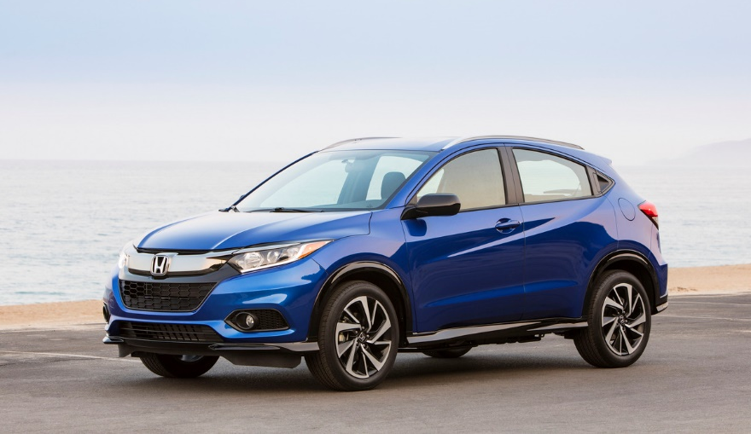
Mexico Sales
2020 Honda HR-V Sport

Slide 25
Honda de Mexico Auto Sales – Honda Division
 |  | June |  |  | YTD
 |  | 2020 | 2019 | % Change* | 2020 | 2019 | % Change*
 | Honda de Mexico Total | 2,798 | 5,952 | -53.0% | 22,176 | 39,046 | -43.2%
 | Honda Division Total | 2,722 | 5,795 | -53.0% | 21,754 | 38,073 | -42.9%
 | Accord | 112 | 187 | -40.1% | 794 | 1,494 | -46.9%
 | City | 1,126 | 941 | +19.7% | 4,215 | 5,769 | -26.9%
 | Civic | 324 | 743 | -56.4% | 2,775 | 5,086 | -45.4%
 | Fit | 56 | 236 | -76.3% | 840 | 1,680 | -50.0%
 | Insight | 16 | 61 | -73.8% | 179 | 314 | -43.0%
 | BR-V | 169 | 340 | -50.3% | 1,751 | 2,753 | -36.4%
 | CR-V | 374 | 1,734 | -78.4% | 5,369 | 10,368 | -48.2%
 | HR-V | 448 | 1,262 | -64.5% | 4,937 | 8,670 | -43.1%
 | Odyssey | 57 | 170 | -66.5% | 551 | 1,189 | -53.7%
 | Pilot | 40 | 121 | -66.9% | 343 | 750 | -54.3%
Cars
Cars
Light Trucks
Light trucks
* Based on year-over-year sales results.
* Based on year-over-year sales results.

Slide 26
Honda de Mexico Auto Sales – Acura Division
 |  | June |  |  | YTD
 |  | 2020 | 2019 | % Change* | 2020 | 2019 | % Change*
 | Honda de Mexico Total | 2,798 | 5,952 | -53.0% | 22,176 | 39,046 | -43.2%
 | Acura Division Total | 76 | 157 | -51.6% | 422 | 973 | -56.6%
 | ILX | 4 | 14 | -71.4% | 24 | 86 | -72.1%
 | NSX | 0 | 0 | --- | 1 | 4 | -75.0%
 | TLX | 7 | 9 | -22.2% | 27 | 94 | -71.3%
 | MDX | 9 | 53 | -83.0% | 68 | 207 | -67.1%
 | RDX | 56 | 81 | -30.9% | 302 | 582 | -48.1%
Cars
Cars
Light Trucks
Light trucks
* Based on year-over-year sales results.

