Slide 1
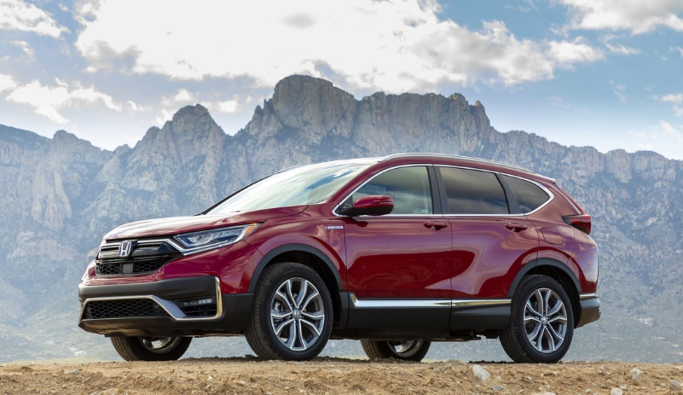
Sales and Production Update
May 2020

Slide 2
North American Auto Production
 |  | 2020 | CY base | May '20 | May '19 | CHG% | 2020 | 2019 | CHG%
 |  |  | MAP | 8,252 | 36,409 | -77.3% | 94,322 | 185,858 | -49.3%
 |  |  | ELP | 5,424 | 19,640 | -72.4% | 61,080 | 100,342 | -39.1%
 |  |  | PMC | 53 | 18 | +194.4% | 173 | 134 | +29.1%
 |  | HAM TTL |  | 13,729 | 56,067 | -75.5% | 155,575 | 286,334 | -45.7%
 |  | HMA |  | 8,618 | 32,168 | -73.2% | 82,317 | 155,707 | -47.1%
 |  | HMIN |  | 5,700 | 20,832 | -72.6% | 62,176 | 104,328 | -40.4%
 |  |  | USA TTL | 28,047 | 109,067 | -74.3% | 300,068 | 546,369 | -45.1%
 |  |  | Plant 1 | 4,751 | 16,612 | -71.4% | 51,953 | 85,569 | -39.3%
 |  |  | Plant 2 | 5,220 | 17,225 | -69.7% | 55,084 | 90,625 | -39.2%
 |  | HCM TTL |  | 9,971 | 33,837 | -70.5% | 107,037 | 176,194 | -39.3%
 |  |  | Guadalajara | 0 | 3,316 | -100.0% | 0 | 18,545 | -100.0%
 |  |  | Celaya | 1,140 | 14,218 | -92.0% | 36,529 | 76,263 | -52.1%
 |  | HDM |  | 1,140 | 17,534 | -93.5% | 36,529 | 94,808 | -61.5%
 |  |  | N.A. TTL | 39,158 | 160,438 | -75.6% | 443,634 | 817,371 | -45.7%
Bottom line: North America sets a new production record for the month of October, breaking the previous record set in 2013.
Bottom line: North America resumed auto production at reduced daily production in mid-May. Combined working days for the month were nearly half the total from May 2019.

Slide 3
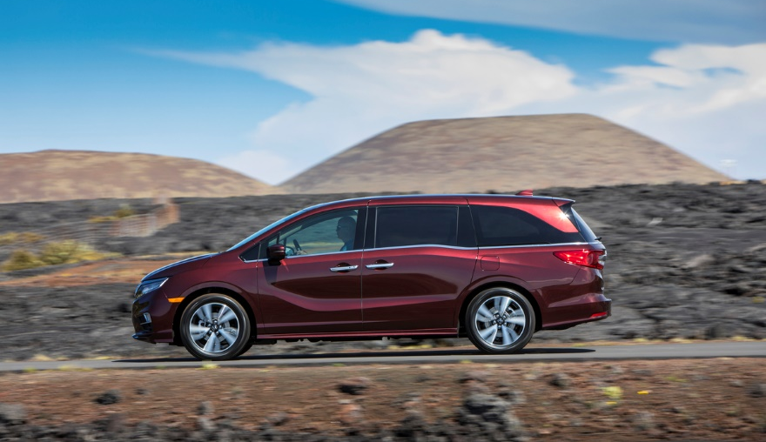
U.S. Sales

Slide 4
American Honda U.S. Auto Sales – Honda Division
 |  | May |  |  | YTD
 |  | 2020 | 2019 | % Change* | 2020 | 2019 | % Change*
 | American Honda Total | 120,977 | 145,532 | -16.9% | 477,513 | 641,094 | -25.5%
 | Honda Division Total | 110,636 | 131,985 | -16.2% | 433,594 | 579,475 | -25.2%
 | Accord | 17,369 | 23,892 | -27.3% | 73,345 | 107,542 | -31.8%
 | Civic | 27,244 | 32,800 | -16.9% | 104,598 | 139,421 | -25.0%
 | Clarity | 248 | 906 | -72.6% | 1,593 | 5,953 | -73.2%
 | Fit | 2,598 | 3,918 | -33.7% | 10,964 | 13,553 | -19.1%
 | Insight | 1,127 | 2,653 | -57.5% | 5,541 | 10,181 | -45.6%
 | CR-V | 29,023 | 30,893 | -6.1% | 112,410 | 146,517 | -23.3%
 | HR-V | 7,063 | 8,565 | -17.5% | 29,383 | 37,486 | -21.6%
 | Odyssey | 7,648 | 9,519 | -19.7% | 27,971 | 38,298 | -27.0%
 | Passport | 3,536 | 3,434 | +3.0% | 12,963 | 11,155 | +16.2%
 | Pilot | 12,227 | 12,517 | -2.3% | 42,687 | 56,873 | -24.9%
 | Ridgeline | 2,553 | 2,888 | -11.6% | 12,138 | 12,494 | -2.8%
Cars
Light Trucks
* Based on year-over-year sales results.
* Based on year-over-year sales results.

Slide 5
American Honda U.S. Auto Sales – Acura Division
 |  | May |  |  | YTD
 |  | 2020 | 2019 | % Change* | 2020 | 2019 | % Change*
 | American Honda Total | 120,977 | 145,532 | -16.9% | 477,513 | 641,094 | -25.5%
 | Acura Division Total | 10,341 | 13,547 | -23.7% | 43,919 | 61,619 | -28.7%
 | ILX | 1,039 | 1,351 | -23.1% | 4,286 | 5,644 | -24.1%
 | NSX | 6 | 30 | -80.0% | 45 | 132 | -65.9%
 | RLX | 71 | 91 | -22.0% | 276 | 623 | -55.7%
 | TLX | 1,467 | 2,235 | -34.4% | 7,975 | 11,360 | -29.8%
 | MDX | 3,331 | 4,425 | -24.7% | 13,997 | 18,547 | -24.5%
 | RDX | 4,427 | 5,415 | -18.2% | 17,340 | 25,313 | -31.5%
Cars
Light Trucks
* Based on year-over-year sales results.

Slide 6
American Honda Monthly Sales Totals
2020
2019
2018
May 2020 Sales – 120,977

Slide 7
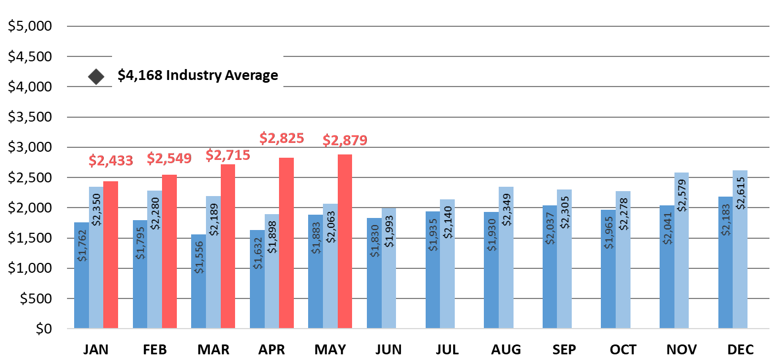
American Honda Auto Incentives
2020
2019
2018
American Honda incentives increased 1.9% from April 2020 and 40% from May 2019.

Slide 8
Honda U.S. Inventory By N.A. Production Model
Average Inventory
March | 123 days
April | 152 days
May | 55 days
Days Inventory at Dealer
Ideal Level
45-55 Days
Passenger Cars
Light Trucks
This inventory level is determined by dividing dealer inventory at the end of the month by average daily sales.
Bottom line: Overall inventory dropped nearly 100 days from April and is now within the ideal level ahead of the traditional strong summer buying season.
* For internal use only

Slide 9
Honda U.S. Inventory – Passenger Cars
Average Inventory
March | 101 days
April | 134 days
May | 51 days
Days Inventory at Dealer
Ideal Level
45-55 Days
Honda Passenger Cars
Acura Passenger Cars
This inventory level is determined by dividing dealer inventory at the end of the month by average daily sales.
Bottom line: Inventory for every passenger-car model dropped dramatically from April, with the Civic below the ideal level ahead of traditionally strong buying months.
* For internal use only

Slide 10
Honda U.S. Inventory – Light Trucks
Average Inventory
March | 144 days
April | 165 days
May | 58 days
Days Inventory at Dealer
Ideal Level
45-55 Days
Honda Light Trucks
Acura Light Trucks
This inventory level is determined by dividing dealer inventory at the end of the month by average daily sales.
Bottom line: Overall light-truck inventory fell more than 100 days from April to May and is now just above the ideal level ahead of the traditionally strong summer buying season.
* For internal use only

Slide 12
U.S. Power Equipment Sales
Power Equipment sales decreased 15% in May compared to 2019, with total unit sales of 152,284.
Honda Marine reported sales of 1,664 units for May, representing an increase of 38%; portable outboards were up 75% and large outboards were up 6% compared to last year.

Slide 13
U.S. Power Equipment Sales
“The summer season is upon us in the U.S., but the world we share is much different than this time last year. With COVID-19 still impacting our everyday lives and continued demands for racial equality and justice in our country, market uncertainty still exists. As some sought refuge with outdoor recreation and work activities, we saw sales gains for different product lines in May, notably for Honda Marine, which reported surges for both of its outboard segments.”
Will Walton
Vice President
Honda Power Equipment Division

Slide 14
Powersports Sales Results

Slide 15
U.S. Powersports Sales
Powersports reported May sales of 36,583 units, a 60% increase vs. 2019.
On-road motorcycle sales increased 3%
Side-by-Side sales were up 108%
Off-road increased 73%
ATV sales grew 89%

Slide 16
U.S. Powersports Sales
“It's encouraging to see such a great consumer response to all our models and the joy they bring to the customer, especially in these times. As we adjust with AHM operational changes, we applaud our network of dealers for making necessary adjustments while meeting customer demand.”
Chuck Boderman,
Powersports Division
Business Unit Head

Slide 17
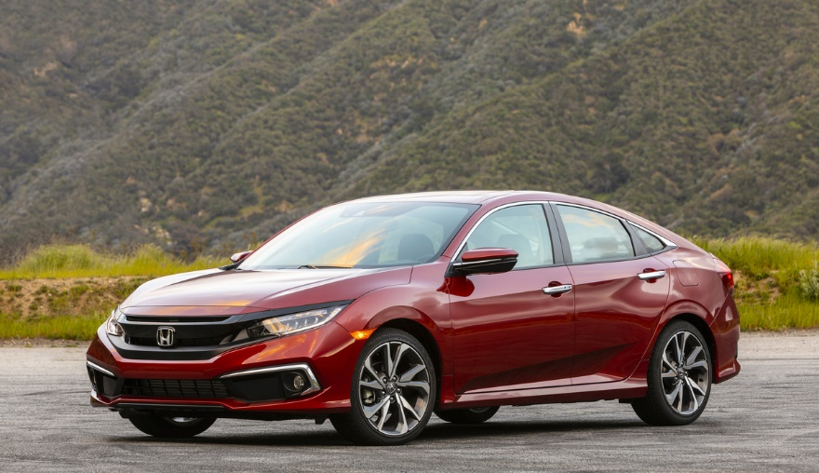
Canada Sales

Slide 18
Honda Canada Auto Sales – Honda Division
 |  | May |  |  | YTD
 |  | 2020 | 2019 | % Change* | 2020 | 2019 | % Change*
 | Honda Canada Total | 10,649 | 20,687 | -48.5% | 42,418 | 79,661 | -46.8%
 | Honda Division Total | 9,454 | 18,827 | -49.8% | 38,441 | 72,020 | -46.6%
 | Accord | 481 | 1,443 | -66.7% | 1,873 | 4,755 | -60.6%
 | Civic | 3,159 | 6,963 | -54.6% | 13,096 | 26,333 | -50.3%
 | Clarity | 71 | 221 | -67.9% | 354 | 522 | -32.2%
 | Fit | 128 | 504 | -74.6% | 513 | 2,040 | -74.9%
 | Insight | 22 | 66 | -66.7% | 152 | 196 | -22.4%
 | CR-V | 3,090 | 5,809 | -46.8% | 13,027 | 23,327 | -44.2%
 | HR-V | 778 | 1,352 | -42.5% | 2,800 | 5,077 | -44.8%
 | Odyssey | 409 | 1,039 | -60.6% | 1,774 | 3,955 | -55.1%
 | Passport | 292 | 357 | -18.2% | 967 | 921 | +5.0%
 | Pilot | 737 | 708 | +4.1% | 2,728 | 3,477 | -21.5%
 | Ridgeline | 287 | 365 | -21.4% | 1,155 | 1,417 | -18.5%
Cars
Light Trucks
* Based on year-over-year sales results.

Slide 19
Honda Canada Auto Sales – Acura Division
 |  | May |  |  | YTD
 |  | 2020 | 2019 | % Change* | 2020 | 2019 | % Change*
 | Honda Canada Total | 10,649 | 20,687 | -48.5% | 42,418 | 79,661 | -46.8%
 | Acura Division Total | 1,195 | 1,860 | -35.8% | 3,977 | 7,641 | -48.0%
 | ILX | 55 | 209 | -73.7% | 180 | 855 | -78.9%
 | NSX | 4 | 6 | -33.3% | 8 | 13 | -38.5%
 | RLX | 1 | 6 | -83.3% | 9 | 23 | -60.9%
 | TLX | 281 | 282 | -0.4% | 849 | 1,689 | -49.7%
 | MDX | 224 | 377 | -40.6% | 762 | 1,799 | -57.6%
 | RDX | 630 | 980 | -35.7% | 2,169 | 3,262 | -33.5%
Cars
Light Trucks
* Based on year-over-year sales results.

Slide 20
Honda Canada Inventory
By N.A. Production Model
Average Inventory
March | 168 days
April | 241 days
May | 196 days
Days Inventory at Dealer
Ideal Level
60-70 Days
Passenger Cars
Light Trucks
Honda Canada utilizes data based on last 60-days of sales to calculate inventory
Bottom line: Overall inventory dropped significantly from April, but remains more than double the ideal level.
* For internal use only

Slide 21
Honda Canada Passenger Car Inventory By N.A. Production Model
Days Inventory at Dealer
Ideal Level
60-70 Days
Honda Passenger Cars
Acura Passenger Cars
Honda Canada utilizes data based on last 60-days of sales to calculate inventory
Bottom line: Aside from the Insight, inventory dropped dramatically for every model.
* For internal use only

Slide 22
Honda Canada Light-truck Inventory By N.A. Production Model
Days Inventory at Dealer
Ideal Level
60-70 Days
Honda Light Trucks
Acura Light Truck
Honda Canada utilizes data based on last 60-days of sales to calculate inventory
Bottom line: Every light-truck model experienced a significant inventory drop from May.
* For internal use only

Slide 23
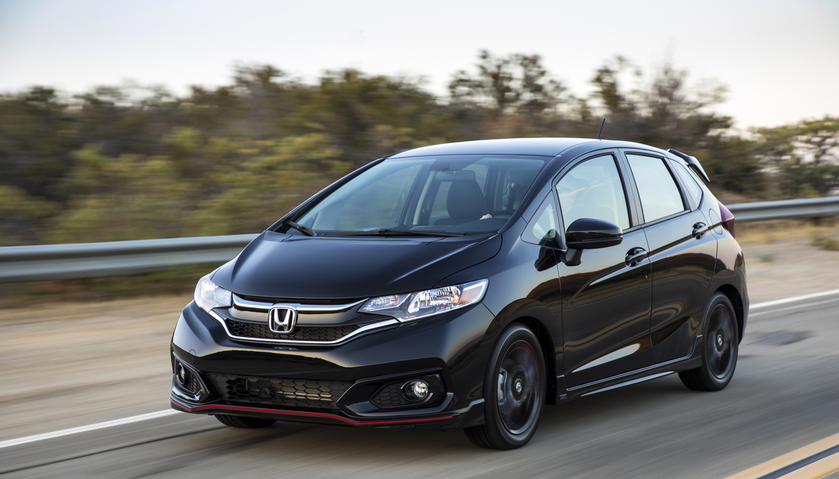
Mexico Sales

Slide 24
Honda de Mexico Auto Sales – Honda Division
 |  | May |  |  | YTD
 |  | 2020 | 2019 | % Change* | 2020 | 2019 | % Change*
 | Honda de Mexico Total | 1,969 | 6,293 | -68.7% | 19,378 | 33,094 | -41.4%
 | Honda Division Total | 1,943 | 6,151 | -68.4% | 19,032 | 32,278 | -41.0%
 | Accord | 74 | 272 | -72.8% | 682 | 1,307 | -47.8%
 | City | 560 | 902 | -37.9% | 3,089 | 4,828 | -36.0%
 | Civic | 260 | 849 | -69.4% | 2,451 | 4,343 | -43.6%
 | Fit | 53 | 378 | -86.0% | 784 | 1,444 | -45.7%
 | Insight | 12 | 40 | -70.0% | 163 | 253 | -35.6%
 | BR-V | 130 | 347 | -62.5% | 1,582 | 2,413 | -34.4%
 | CR-V | 380 | 1,554 | -75.5% | 4,995 | 8,634 | -42.1%
 | HR-V | 397 | 1,507 | -73.7% | 4,489 | 7,408 | -39.4%
 | Odyssey | 48 | 175 | -72.6% | 494 | 1,019 | -51.5%
 | Pilot | 29 | 127 | -77.2% | 303 | 629 | -51.8%
Cars
Cars
Light Trucks
Light trucks
* Based on year-over-year sales results.
* Based on year-over-year sales results.

Slide 25
Honda de Mexico Auto Sales – Acura Division
 |  | May |  |  | YTD
 |  | 2020 | 2019 | % Change* | 2020 | 2019 | % Change*
 | Honda de Mexico Total | 1,969 | 6,293 | -68.7% | 19,378 | 33,094 | -41.4%
 | Acura Division Total | 26 | 142 | -81.6% | 346 | 816 | -57.6%
 | ILX | 1 | 24 | -95.8% | 20 | 72 | -72.2%
 | NSX | 0 | 0 | --- | 1 | 4 | -75.0%
 | TLX | 2 | 15 | -86.7% | 20 | 85 | -76.5%
 | MDX | 2 | 29 | -93.1% | 59 | 154 | -61.7%
 | RDX | 21 | 74 | -71.6% | 246 | 501 | -50.9%
Cars
Cars
Light Trucks
Light trucks
* Based on year-over-year sales results.

